Slide 1
Group 1
Happy
Nicholai

Slide 2
Approach & Methodology
Two main approaches (optional: classic ML vs. deep learning)
Why you chose BERT: “BERT captures context and meaning better than traditional models.”
Minimal preprocessing for BERT (combine title + text, handle long texts with truncation)
Use of a pretrained BERT model: jy46604790/Fake-News-Bert-Detect
Loaded via Hugging Face’s pipeline
Batched inference for efficiency

Slide 3
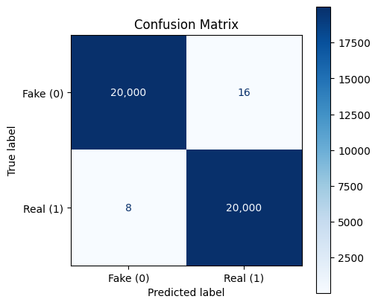
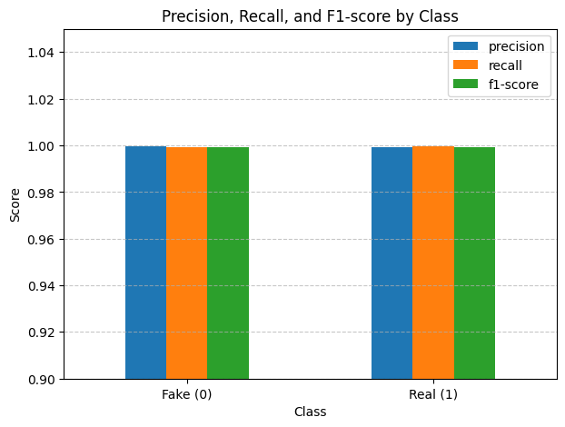
Results
Add your confusion matrix of your BEST MODEL

Slide 4
Discussion
BERT’s deep context awareness makes it very effective for nuanced text tasks like fake news detection.
Exhibits the power of transfer learning and publicly available models (we used a model already fine-tuned for fake news from Huggingface)
Limitations include:
Potential for data leakage
Generalization to new types of fake news
Computational cost

